Slide 1


Acquisition system with an Android application
18/07/2024
Student: Maxime Wissocq
Internship tutor: Romuald Jolivot
1

Slide 2
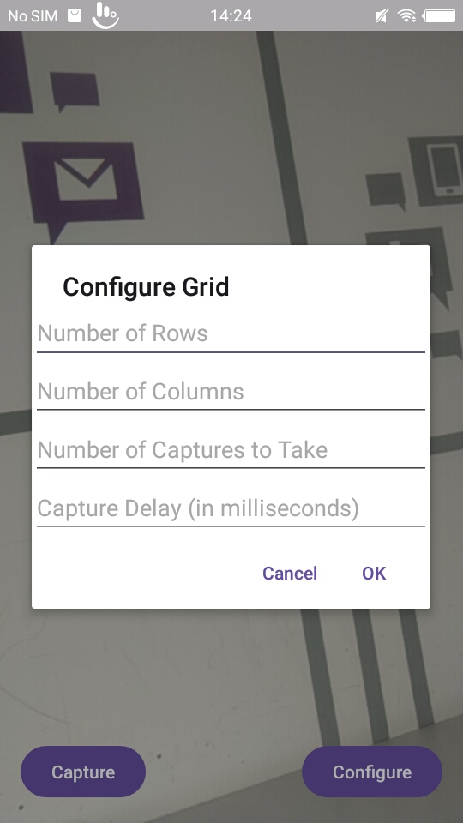
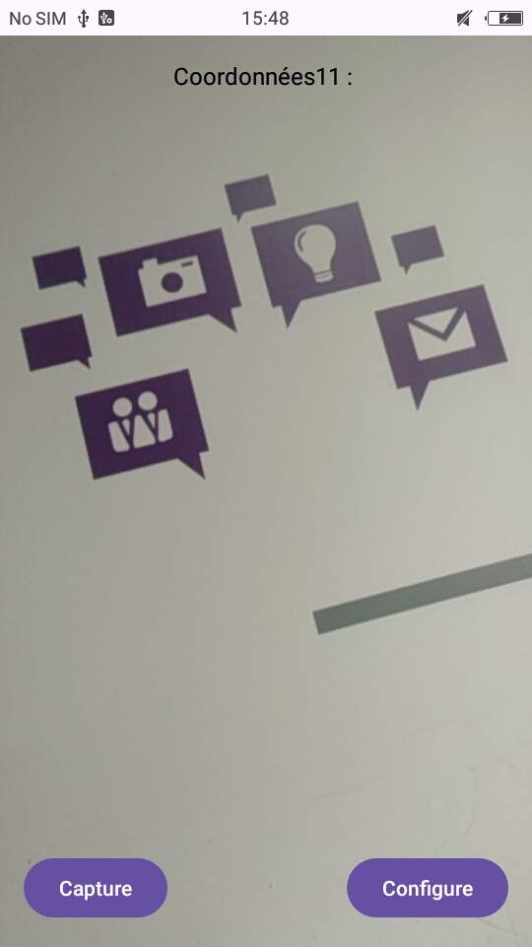
Feature #1: Image acquisition
Takes picture(s) by clicking
Set the number of pictures and the delay between each picture (timelapse)
5

Slide 3
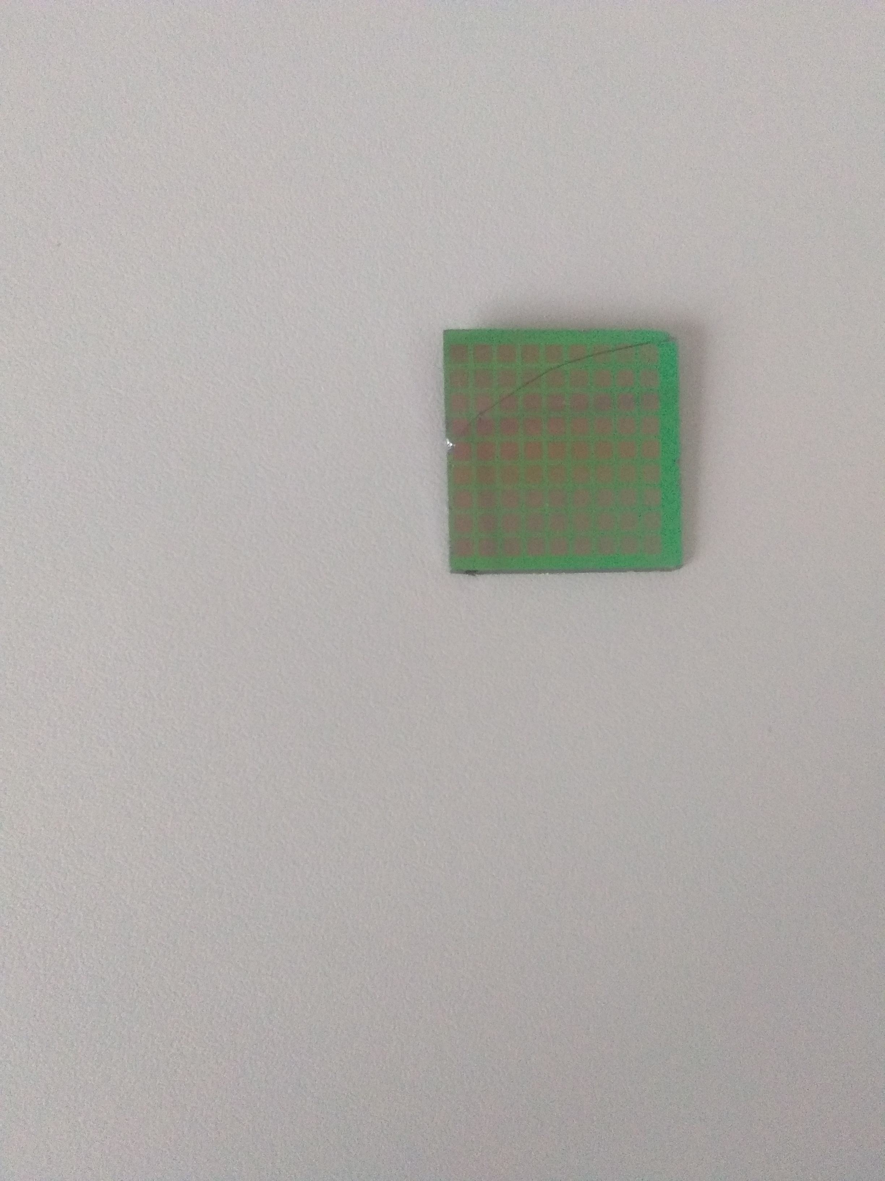
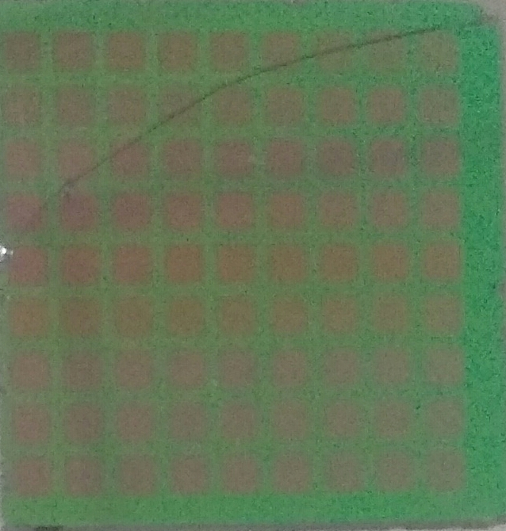
Feature #2: sensor detection
Thresholding
After the removal of high value pixels
RGB (200,200,200)
8

Slide 4
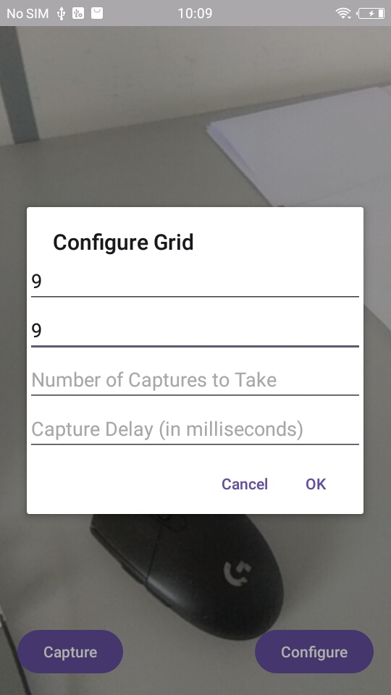
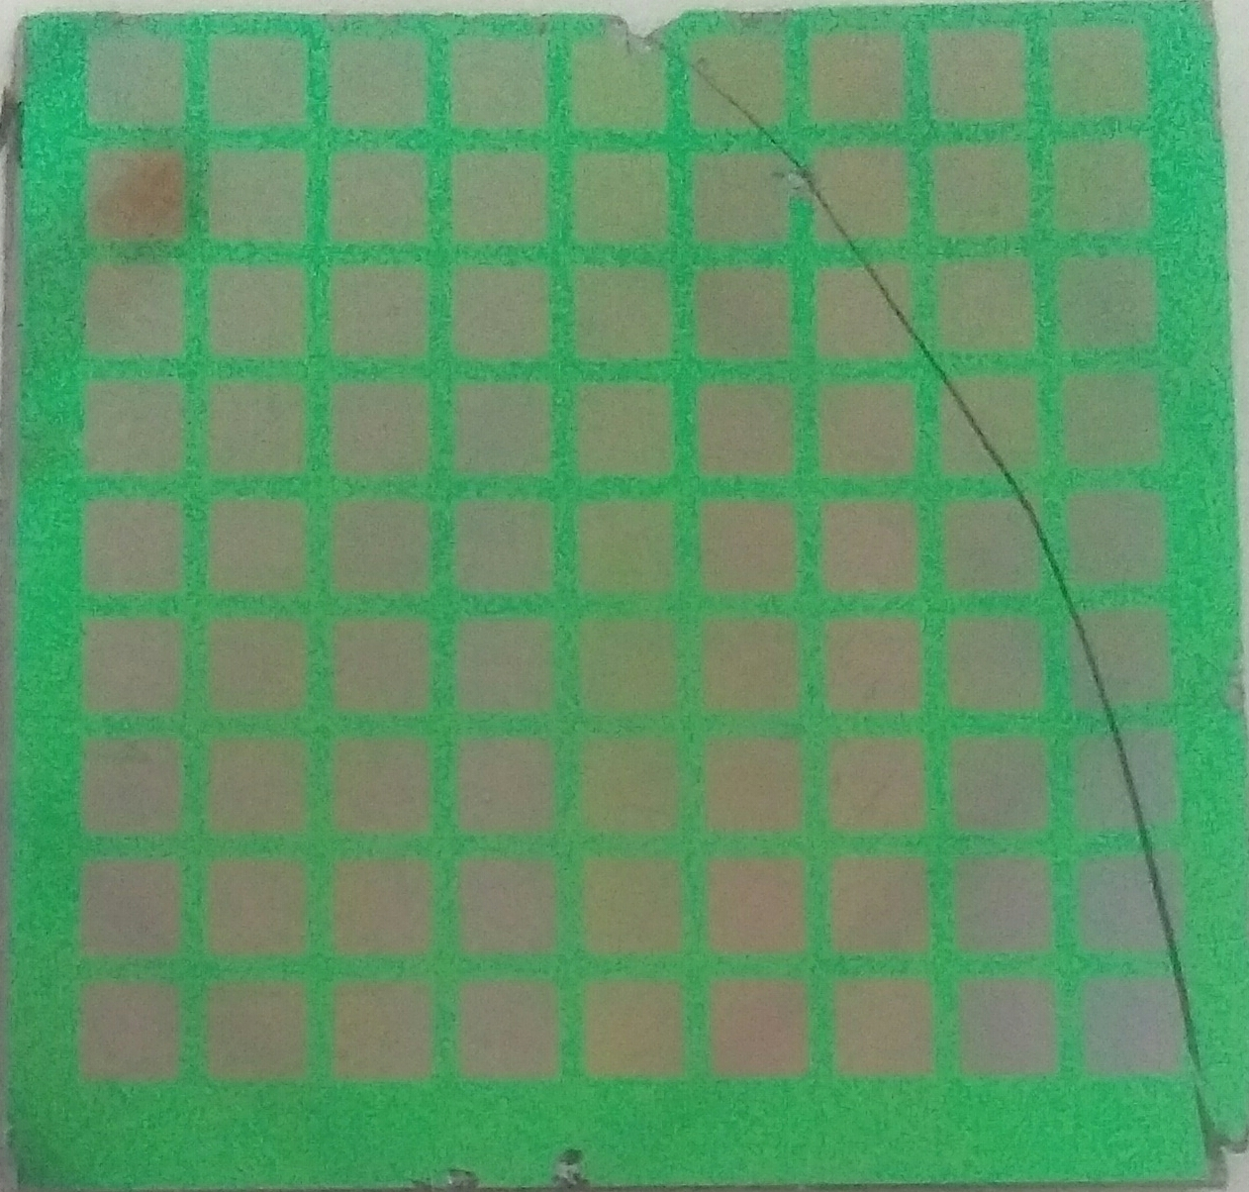
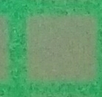
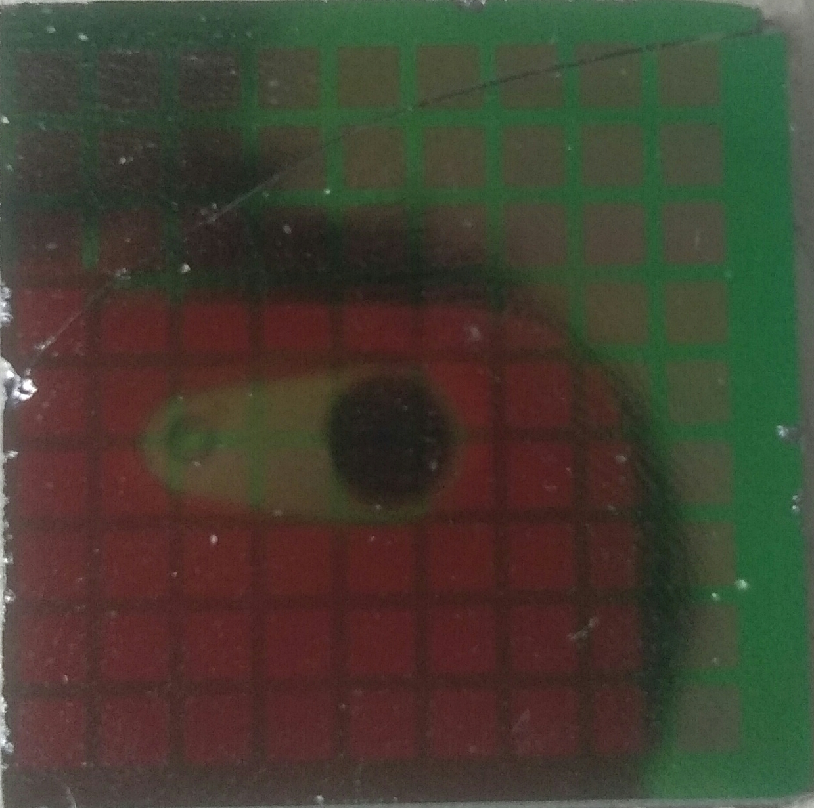
Feature #3: data extraction
One of the 81 sensors
Division into 81 individual sensors
Average RGB values calculated in the center of this sensor
9

Slide 5
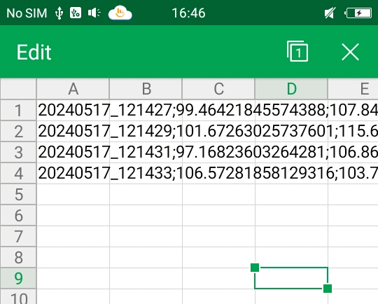
Feature #4: data recording
CSV file for 4 captures with a 2 seconds delay
Acquisition time
Average RBG values for each sensor extracted from the image
10

Slide 6
Thanks for listening
13

